Slide 1

Digital Portfolio
STUDENT NAME : VINDHYA LAKSHMI V
REG NO & NMID : asbru4w2422k2148
DEPARTMENT : BSc COMPUTER SCIENCE
COLLEGE : BHARATHIAR UNIVERSITY

Slide 2
PROJECT TITLE
Vindhya’s Portfolio

Slide 3
Agenda
1. Problem Statement
2. Project Overview
3. End Users
4. Tools and Technologies
5. Portfolio design and Layout
6. Features and functionality
7. Results and Screenshots
8. Conclusion
9. Github Link

Slide 4
PROBLEM STATEMENT
In a competitive job market, a static resume often fails to capture the full scope of a person’s abilities and creative work
The digital landscape demands more than just a list of qualifications; it requires a dynamic and comprehensive showcase of one’s professional journey.
Many individuals struggle to effectively bridge the gap between their printed credentials and the rich, multimedia work they have produced.
This leaves valuable projects and skills overlooked by potential employers and collaborators.

Slide 5

Project Overview
This project is a personal portfolio website that I developed to showcase my projects, skills, and professional journey. This site includes sections for my work, resume, and contact information, providing a structured and engaging platform to demonstrate my capabilities in a clear and visual manner.
My portfolio contains (Home, About me, My services, My skills, Project Contact).
My portfolio website is a digital platform created to effectively showcase my personal achievements, key projects, and professional skills. It provides a comprehensive and interactive way to present my work to potential employers and collaborators.

Slide 6
Who are the end users?
Students can showcase their academic projects and skills.
Job Seekers can highlight a diverse range of projects and experience for potential employers.
Freelancers : To demonstrate their expertise and built credibility with prospective clients.
Professionals : To create a dynamic record of their accomplishments and career progressions.
1
2
Job seekers
Professionals
Students
4
3
Freelancers
6

Slide 7

Tools and Techniques
HTML :
To create the structure and content of the web page. It define elements like headings, paragraphs, links, images, and more. It is the skeleton of a web page.
Html uses tags to organize content into a logical hierarchy.
Html provides tags like <form>, <input>, <button>.
7

Slide 8

Tools and Technology
CSS
CSS is a language used to style the visual representation of a web page. It controls the colours, fonts, layout, and overall design.
One of the biggest advantage of CSS is that it separates the design of a website from its content. This means you can change the look of an entire website by editing just a few lines of CSS, without touching the HTML. This makes web development much more efficient and maintainable.
CSS allows us to arrange elements on a page. We can set the size and position of images, create columns, and design.

Slide 9
Tools and Techniques
Javascript
JavaScript is a programming language used to add interactivity and dynamic behaviour to web pages. JavaScript allows a website to respond to user actions and display real-time changes. It’s the behaviour or action layer of a website. It can respond to clicks, key presses, and mouse movements.
Beyond just adding small interactive elements, JavaScript is the foundation for building complex web applications, such as online games, social media, and real-time chat applications. Libraries and frameworks like React, Angular are built on JavaScript to simplify the development of these applications.

Slide 10
Portfolio Design and Layout
SECTION :
There are five sections included in my project.
HOME :
This is my personal portfolio homepage, designed to introduce myself and showcase my skills as a web developer.
I have included a set of four social media icons ( Meta, Instagram, Twitter, and LinkedIn ) these are not clickable because I haven’t added the interactive features.
The overall design uses a dark, minimalist theme with a bright blue color. This create a professional and modern aesthetic, making the text easy to read and drawing attention to the key elements on the page.
SERVICES :
This page is dedicated to outlining the professional services I offer as a web developer. The goal is to clearly present my expertise and help potential clients understand how I can meet their needs.
10

Slide 11
Portfolio Design and Layout
SKILLS :
My expertise lies in HTML, CSS, JavaScript, and React. I build clean, efficient code that powers modern web applications and seamless functionality. I combine this technical foundation with a strong sense of creativity and communication to deliver high-quality web solutions.
CONTACT :
This page is designed to show how a user could get in touch with me. It displays a standard contact form layout.
Full Name
Email Address
Mobile No
Email
Message box
While it is not functional, it’s a critical component of a professional portfolio
RESPONSIVE LAYOUT :
A responsive layout is a web approach that makes a website or application adapt and look good on any screen size, from a large monitor to a small smart phone.
Instead of creating a separate website for each devices, a responsive design uses a flexible grids, images and CSS media queries to automatically resize and rearrange the content.
11

Slide 12
FEATURES AND FUNCTIONALITY
Navigation bars with smooth scrolling.
Project showcase with images and details
Interactive elements (hover effects, animations).
Contact form (with validation).
Responsive design for all devices.
12

Slide 13
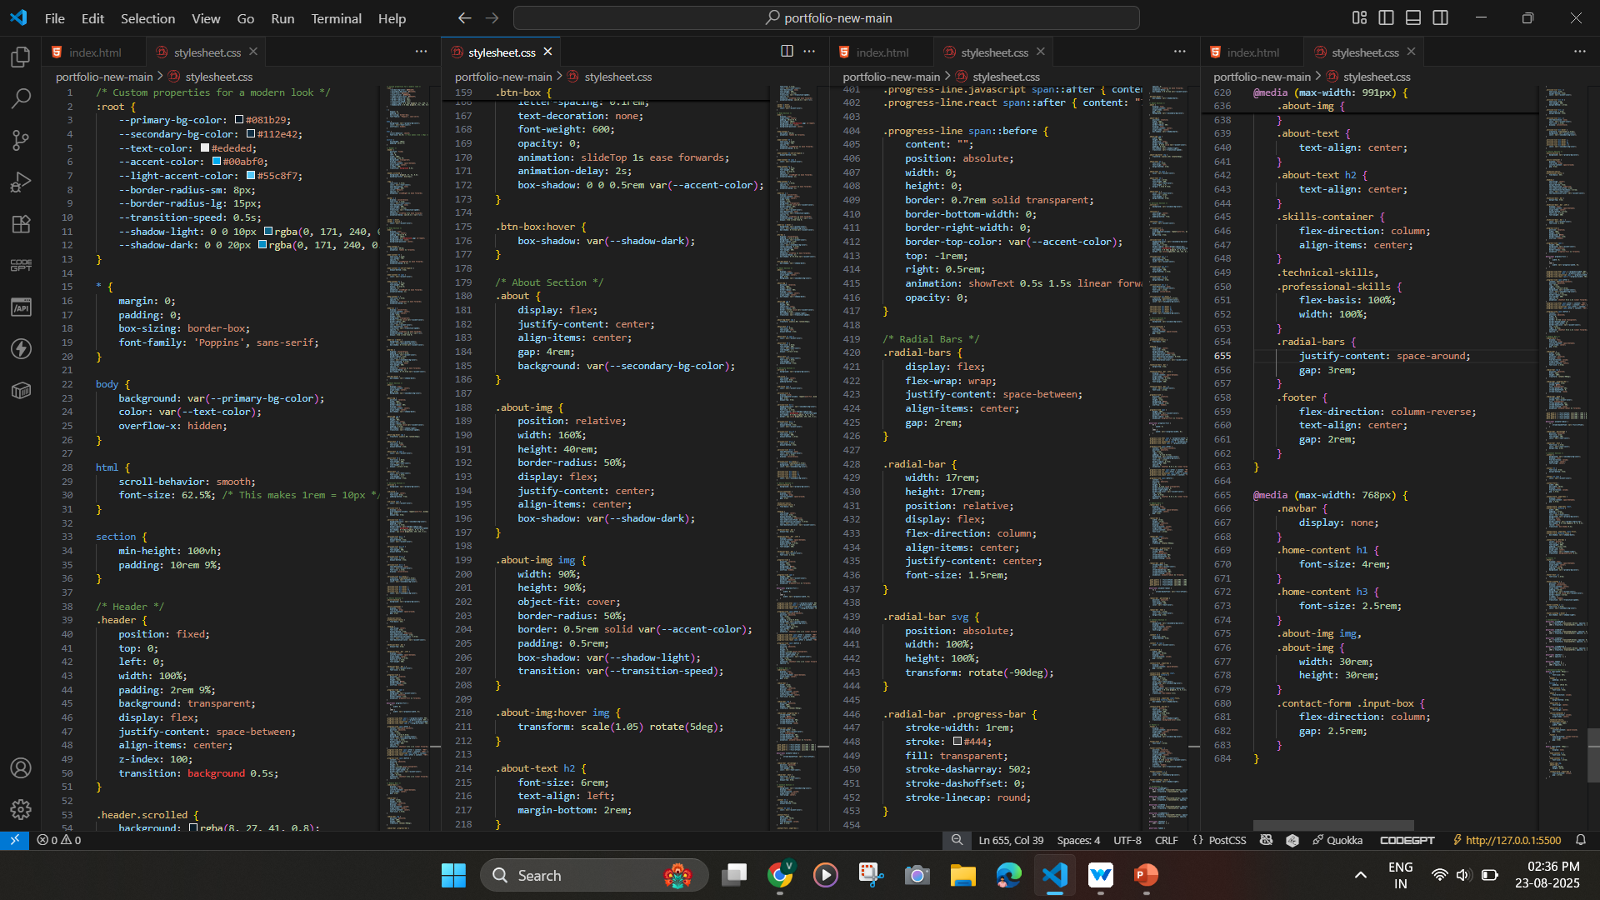
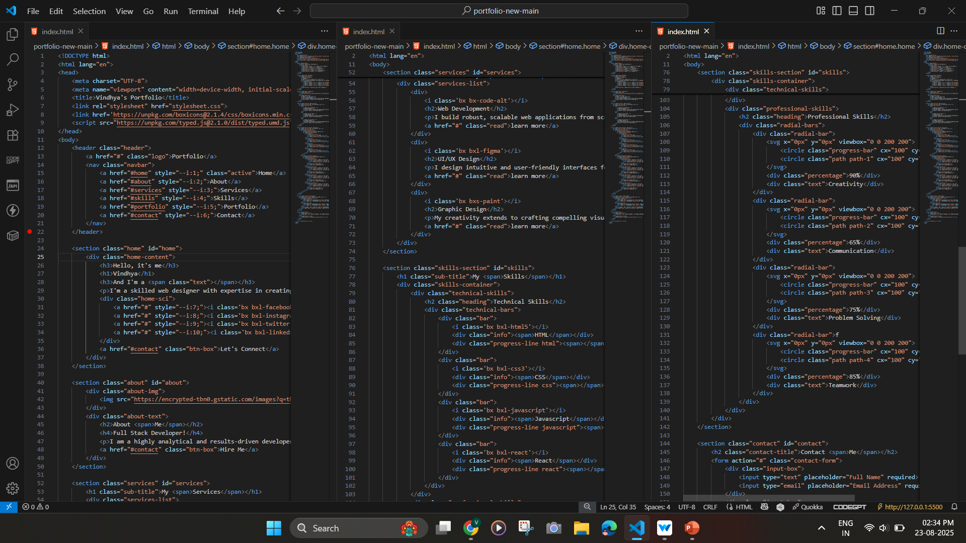
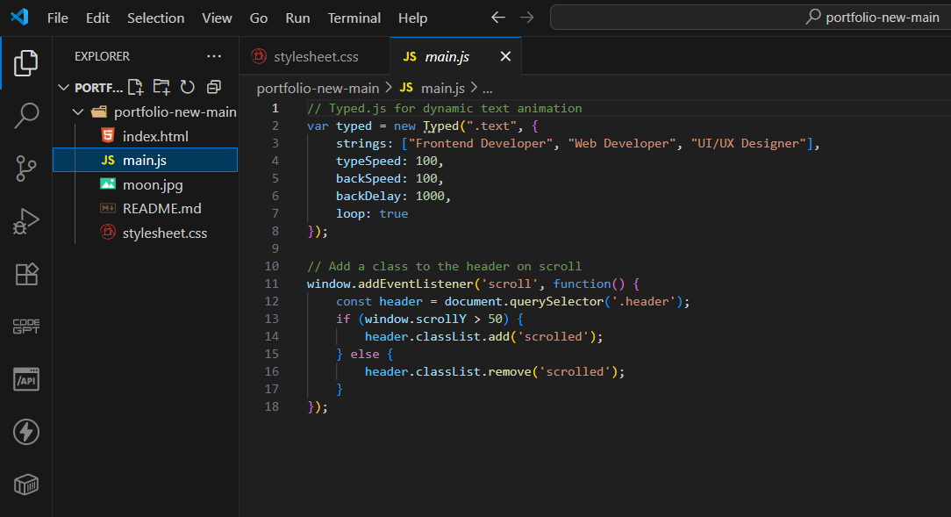
RESULTS AND SCREENSHOTS
CSS
HTML
Javascript

Slide 14
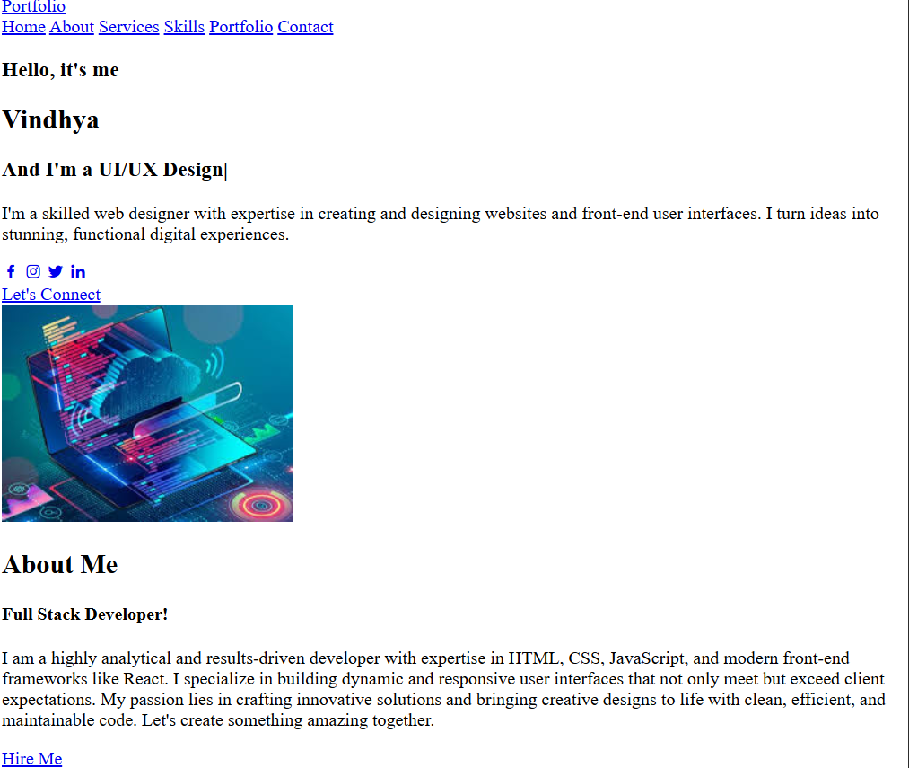
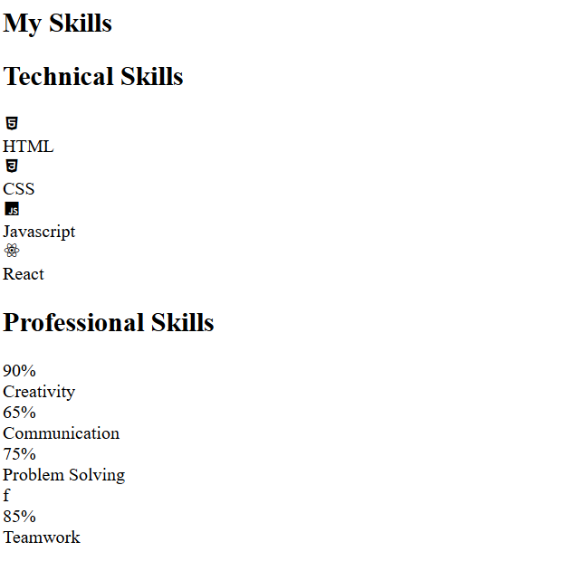
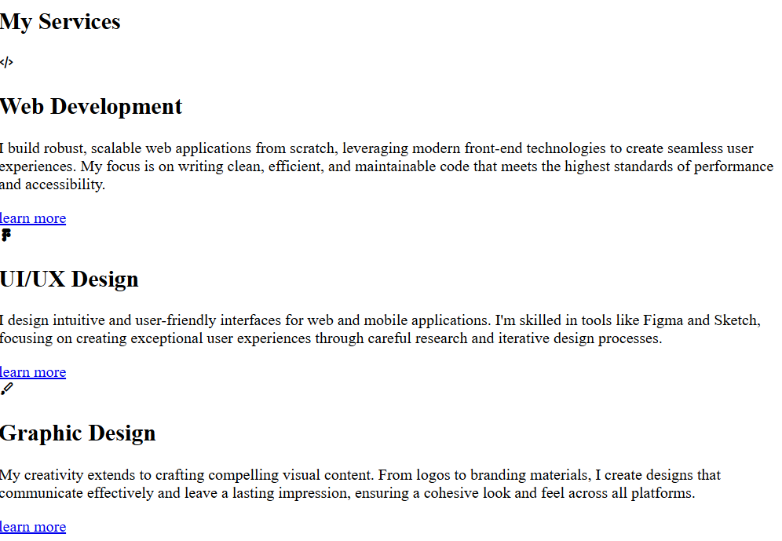
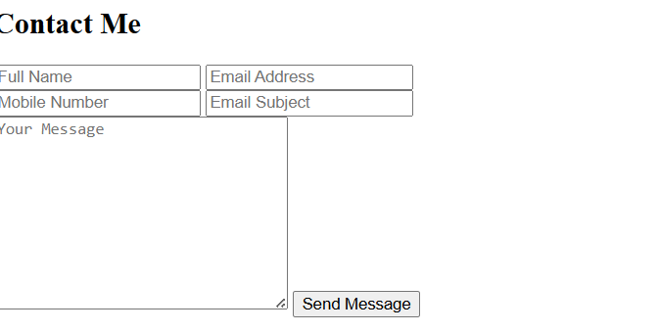
RESULTS AND SCREENSHOTS (Before CSS)

Slide 15
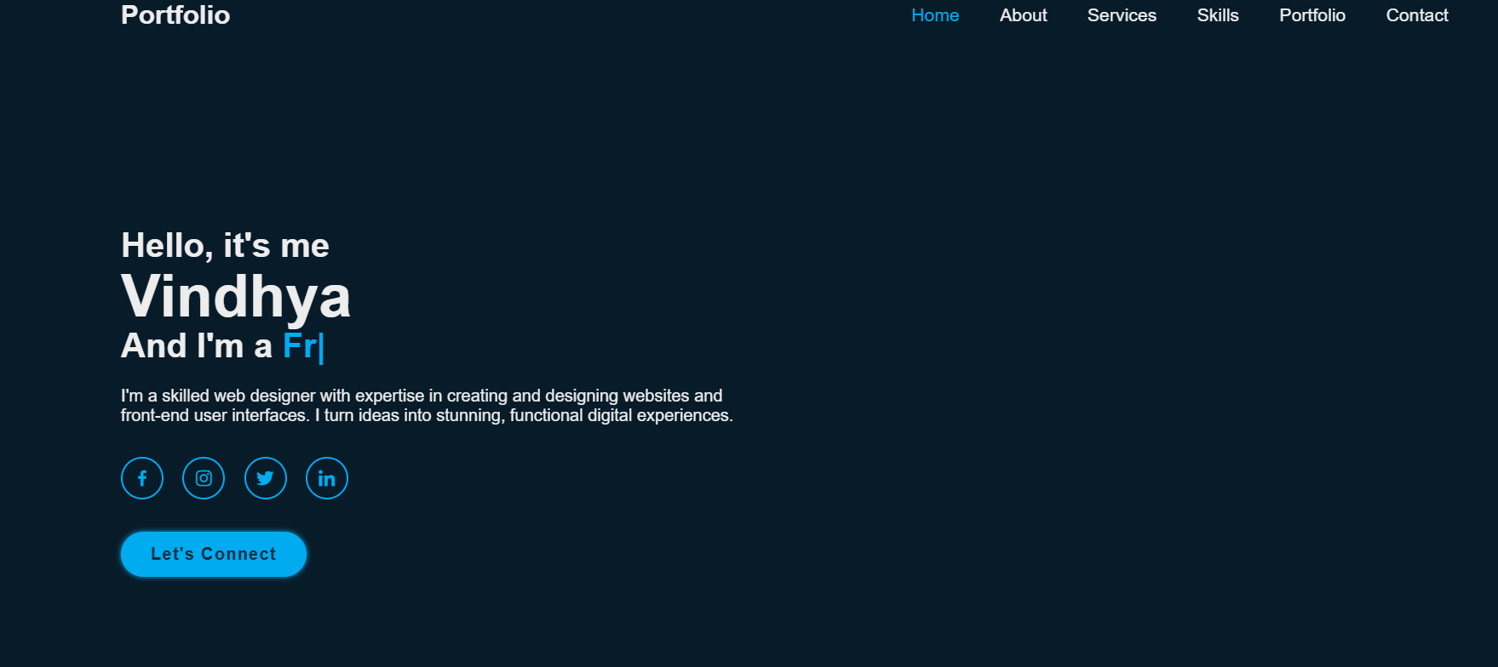
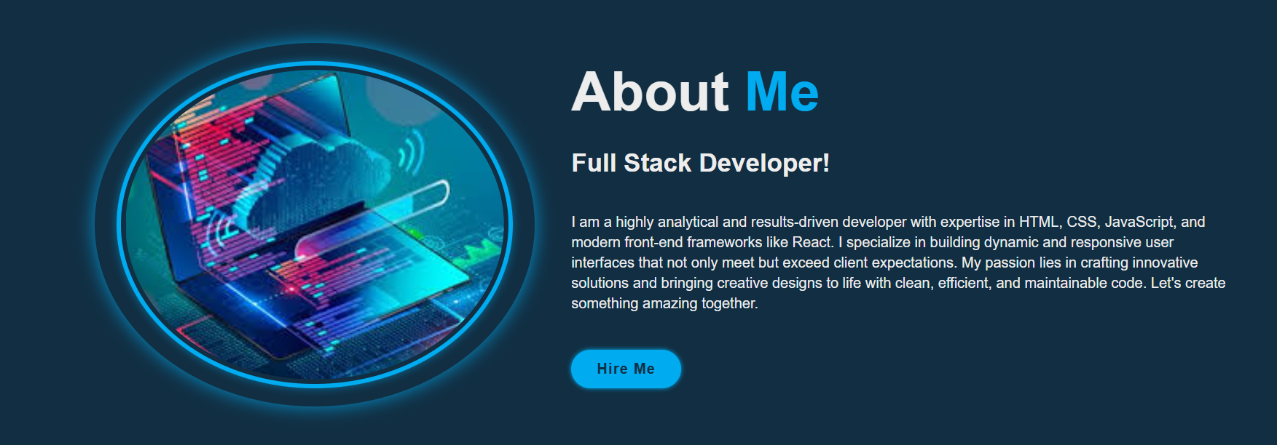
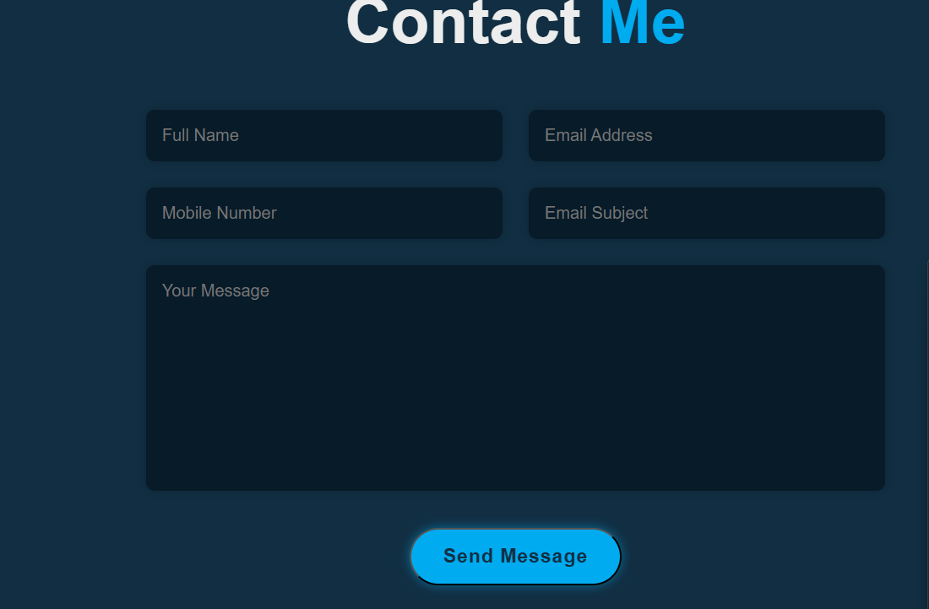
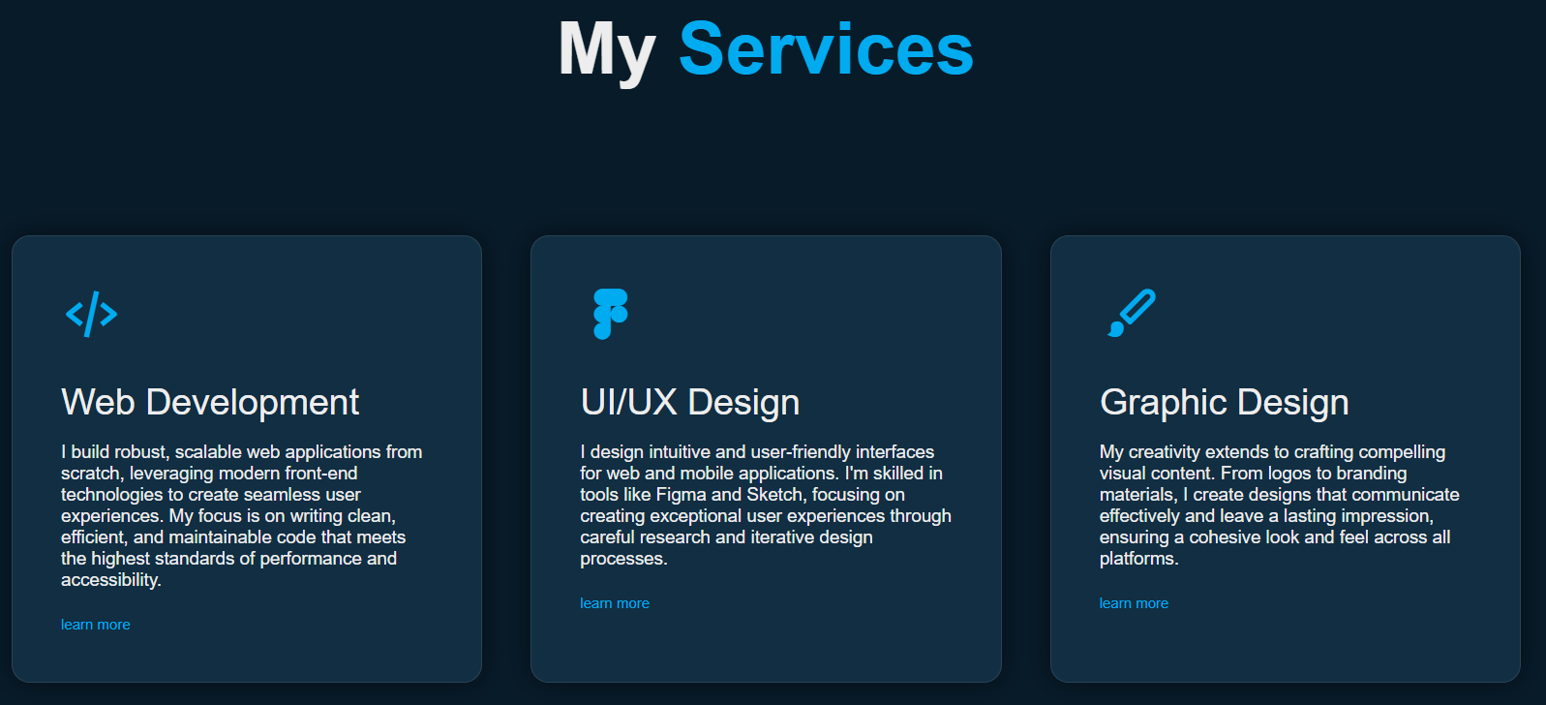
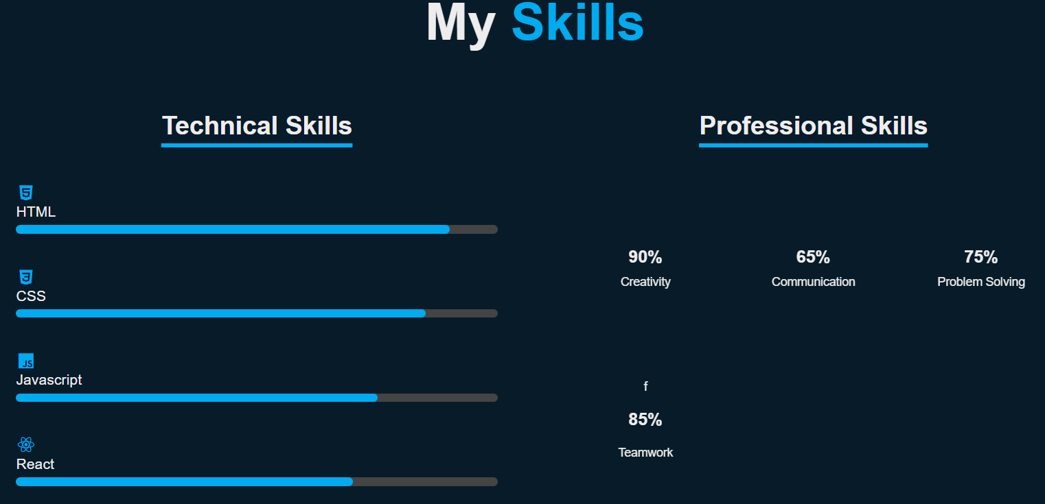
RESULTS AND SCREENSHOTS (With CSS & JS)

Slide 16
CONCLUSION
HIGHLIGHTS :
In this project, I successfully developed a fully responsive and professional portfolio website using modern web technologies.
FINAL SUMMARY :
This project demonstrates my proficiency in HTML, CSS, JavaScript. By leveraging these skills, I was able to build a scalable and efficient application that showcase my abilities.
BENEFITS TO SOCIETY :
Many Computer Science graduates, despite having a degree, struggle to land a job because they lack a way to effectively showcase their practical skills. Resumes and transcripts can’t fully demonstrate a candidate’s abilities to code, solve problems, and build projects. So there is a solution , online portfolio website tackles this problem directly by providing a platform where job seekers can visually and interactively present their work. By hosting a collection of projects, case studies, the website allows employer to see a candidate’s capabilities firsthand. This leads to a more merit-based hiring process and helps close the gap between educational achievements and career opportunity.

